Slide 1

A CLOUD-NATIVE ARCHITECTURE FOR SCALABLE AND EFFICIENT LEARNING MANAGEMENT SYSTEMS
1

Slide 2






MEET OUR TEAM
Shariful Islam Sajib Sarker
Kamrul Huda Sattari Saad
Kamrun Nahar Mitu
Md Tajbeer Ahamed Rimon
ID: 2125051016
ID: 2125051041
ID: 2125051019
ID: 2125051007
Batch: 50
Batch: 50
Batch: 50
Batch: 50
Section: 7A
Section: 7A
Section: 7A
Section: 7A
2

Slide 3
TODAY'S AGENDA
1
Introduction
6
Methodology
2
Background
7
Results
3
Problem Statement
8
Discussion
4
Research Objectives
9
Conclusion
5
Literature Review
10
References
3

Slide 4

INTRODUCTION
Topic: Digital transformation of education and its challenges.
Key Focus:
Importance of Learning Management Systems (LMS).
Existing LMS limitations in scalability, cost-efficiency, and integration.
4

Slide 5

Key Challenges:
Architectural rigidity and limited scalability.
High costs and operational inefficiencies.
Lack of integration with modern technologies like AI.
User experience issues.
Security vulnerabilities.
RESEARCH PROBLEM
5

Slide 6
RESEARCH OBJECTIVES
Analyze current LMS limitations.
Propose a cloud-native architectural solution.
Highlight performance and efficiency improvements.
Evaluate economic and technological advantages.
Provide a replicable model for digital learning infrastructure.
6

Slide 7
LITERATURE REVIEW
EVOLUTION OF LMS:
2000s: Integrated Platforms
2010s: Cloud-Initiated
2020s: Cloud-Native system
initiate content management and user authentication.
Monolithic architectures with scaling challenges.
Initial cloud integration and mobile accessibility.
Vendor-locked solutions with partial scalability.
Microservices and AI-driven platforms.
Real-time collaboration tools with adaptive learning.
7

Slide 8


CLOUD COMPUTING IN EDUCATION
The study explores how cloud computing has transformed education by offering scalable and on-demand resources.
Key Benefits of Cloud Computing:
On-demand resources reduce infrastructure costs.
Scalable architecture to handle dynamic educational demands.
Flexibility to integrate emerging technologies.
8

Slide 9
METHODOLOGY
Proposed Cloud-Native Architecture
Key Components of the Architecture
Design Objective:
Address the limitations of traditional LMS by enhancing scalability, efficiency, and adaptability using cloud-native technologies.
Client Layer
AWS Application Services
Microservices Architecture
Storage & Media Solutions
Security & Monitoring
9

Slide 10
METHODOLOGY
Approach:
Containerization:
Dockerized services ensure consistent deployments and efficient scaling.
Orchestration:
Kubernetes automates service scaling and management.
Testing Framework:
Multi-layered testing (unit, end-to-end) ensures system stability.
10

Slide 11
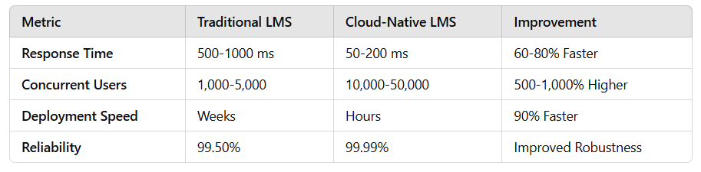
PERFORMANCE METRICS
11

Slide 12
RESULTS
Improvements in Scalability:
Higher user support during peak times.
Faster deployment.
Lower costs through pay-as-you-go models.
Economic Benefits:
Reduced capital expenditures.
Predictable operational costs.
12

Slide 13
DISCUSSION
Technological Impact:
Accelerated innovation and seamless AI integration.
Improved data-driven decision-making in education.
Limitations:
High initial migration costs.
Vendor lock-in with cloud providers.
13

Slide 14
CONCLUSION
Cloud-native architectures offer enhanced scalability, flexibility, and efficiency.
Significant improvements in response time, user capacity, and cost optimization.
Pay-as-you-go models reduce upfront costs and ensure sustainable resource allocation.
Achieving near-perfect system uptime (99.99%) ensures uninterrupted learning experiences.
14

Slide 15
FUTURE RESEARCH DIRECTIONS
Advanced AI and adaptive learning pathways.
Enhanced security protocols.
Interoperability between LMS systems.
Long-term cost sustainability.
15

Slide 16
REFERENCES
M. Brown and R. Johnson, "Cloud Computing in Higher Education: Transformative Architectural Approaches," International Journal of Educational Technology, vol. 45, no. 3, pp. 112-129, Sep. 2022.
S. Chen, L. Wang, and J. Zhang, "Microservices Architecture for Scalable Learning Management Systems," IEEE Transactions on Learning Technologies, vol. 15, no. 2, pp. 245-260, Jun. 2021.
A. Kumar and P. Sharma, "Performance Analysis of Cloud-Native Educational Platforms," ACMDigital Education Review, vol. 38, no. 4, pp. 76-92, Dec. 2022.
R. Thompson, "Distributed Computing Principles in Educational Technology," Journal of Cloud Computing and Education, vol. 22, no. 1, pp. 33-47, Mar. 2023. Page 8 of 9 Optimizing Educational Technology
E. Rodriguez and K. Lee, "Security Protocols in Cloud-Based Learning Management Systems," International Cybersecurity in Education Journal, vol. 19, no. 3, pp. 201-218, Nov. 2022.
OpenAI. (2024). ChatGPT [Large language model]. https://chatgpt.com
16

Slide 17

THANK YOU
17

